Slide 1
WWI Begins
A summary of what you probably already know…

Slide 2
Lecture objectives
Explain the causes of World War I.
Discuss the impact new technology had on warfare.
Identify members of the Triple Entente (allied powers) and Triple Alliance (central powers) and determine the difference between the two.

Slide 3
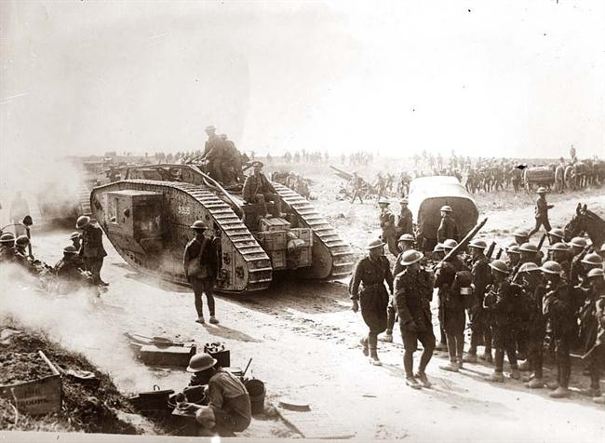
Causes of WWI
4 long-term causes of WWI:
Nationalism
Imperialism
Militarism
Alliance system

Slide 4
Breaking down the causes
Nationalism: the devotion to the interests and culture of one’s nation, which often led to competitive and antagonistic rivalries among different nations
Imperialism: the policy in which stronger nations extend their economic, political, or military control over weaker territories
Militarism: the development of armed forces and their use as a tool of diplomacy
Alliance system: a formal agreement or union between nations

Slide 5
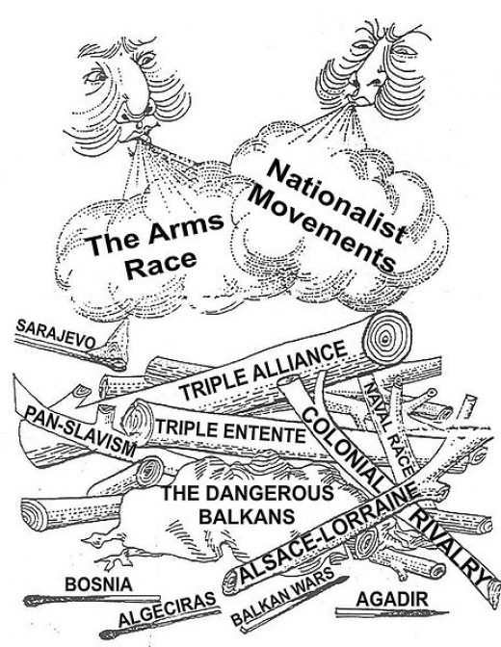

Slide 6
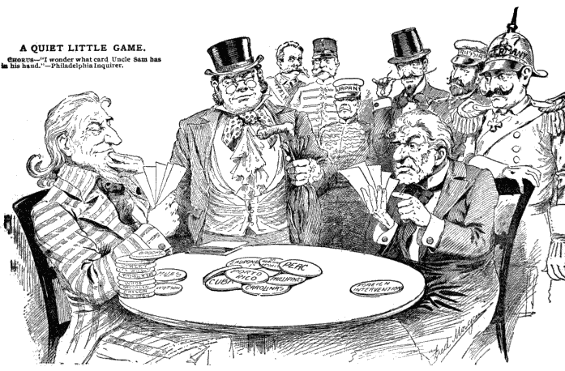
The alliances
The Triple Entente (Allies): France, Britain, Russia
The Triple Alliance (Central Powers): Germany, Austria-Hungary, Italy
Alliances provided international security , or did they?!

Slide 7
Assassination leads to war
The Balkan Peninsula was known as “the powder keg of Europe.”
Europe’s leading powers had interest in the area:
Russia wanted access to the Mediterranean Sea
Germany wanted a rail link to the Ottoman Empire
Austria-Hungary accused Serbia of subverting its rule over Bosnian (Serbs encouraging Bosnian resistance to Austria-Hungry rule)

Slide 8
June 28, 1914
Archduke Franz Ferdinand heir to the Austrian throne, visited the Bosnian capital Sarajevo.
While driving through the city a Serbian nationalist Gavrilo Princip stepped from the crowd and shot the Archduke and his wife.
Princip was a member of the Black Hand (organization promoting Serbian nationalism)
Assassination began a domino effect of diplomatic crises

Slide 9
Gavrilo Princip’s Arrest

Slide 10
July 28, 1914
Austria-Hungary declared war against Serbia
Serbia refused to apologize and did not meet all of Austria-Hungary’s demands
Agreement to demands would have challenged Serbia’s sovereignty
→The ALLIANCE SYSTEM pulled one nation after another into the conflict (Entanglement)

Slide 11
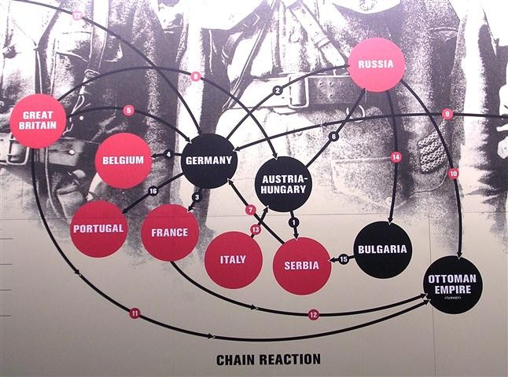

Slide 12
Horrible Histories Video Clip
Causes of WWI
http://www.youtube.com/watch?v=tsnH8WX1MHY

Slide 13
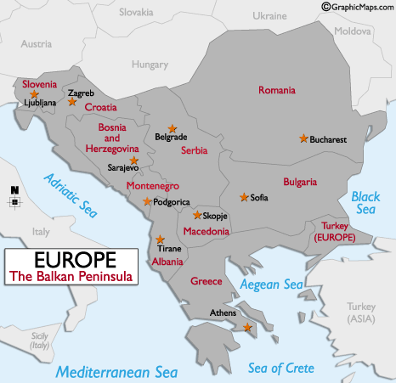
July 30, 1914
Russia promised to protect Serbia,
so they started mobilizing their troops
Called for the end of mobilization
of Russian troops, they refused and France (who was allied with Russia) started mobilizing their troops

Slide 14
August 1, 1914
Germany obligated to support Austria-Hungary declared war on Russia
(did not want to be trapped in between France and Russia)
Italy declares its neutrality.
Germany and the Ottoman Empire sign a secret alliance treaty

Slide 15
August 3-4, 1914
Germany declared war on France which was Russia’s ally
because they Believed they needed to strike first
Belgium does not allow German arms through to the French border
After Germany invaded Belgium, Britain (protector) declared war on Germany and Austria-Hungary.

Slide 16
The Schlieffen plan

Slide 17
The Schlieffen plan
Germany invaded Belgium following a strategy known as the Schlieffen Plan: argued that if war took place it was vital that France was quickly defeated.
If this happened, Britain and Russia would be unwilling to carry on fighting.
Schlieffen calculated that it would take Russia six weeks to organize its large army for an attack on Germany.
Therefore, it was extremely important to force France to surrender before Russia was ready to use all its forces.

Slide 18
Fighting begins
German forces swept across Belgium
Allies retreated to the Marne River in France where they stopped the invasion in September 1914
Both sides began to “dig in” in preparation for a long siege
German soldiers occupied one set of trenches, Allied soldiers the other and between the trenches was called “no man’s land”

Slide 19
Horrible Histories Video Clip
The British Trenches
http://www.youtube.com/watch?v=qzzXPkAdQXQ
What other countries were mentioned fighting with the british?

Slide 20
Trench Warfare

Slide 21
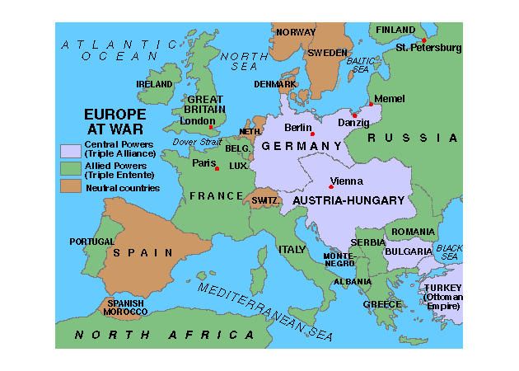

Slide 22
Industrialization → Modern Warfare and new technology →slaughter
machine guns, hand grenades, artillery shells, airplanes, tanks, zeppelins, poisonous gases and other new technologies changed how war was fought forever, and resulted in unimaginable slaughter when combined with trench warfare. This led to a:
War of Attrition: a war where each side tried to wear down the enemy gradually by inflicting enormous losses.

Slide 23
Horrible Histories Video Clip
Life in the Trenches
Winter in the Trenches

