Slide 1
Native American Removal
Westward expansion unit

Slide 2
European arrivals to north America 1500s and 1600s
Epidemic disease is the overwhelming cause of the population decline of the Native Americans caused by a lack of immunity to new diseases brought from Europe
Native Americans are displaced from their lands either by force or through treaties caused by expanding European settlement
As tribes move west it also causes intertribal warfare
Also remember Native Americans do not believe in the concept of land ownership

Slide 3
US government Policies of removal
Indian Removal Act of 1830 : Allowed the government to negotiate removal treaties with the various Native American tribes.
Assimilation Policy: the process of a minority culture changing to resemble the dominant culture– encouraging or forcing Native Americans to become ‘civilized’ by adopting Anglo-American customs. Example: Boarding Schools 1890-1910

Slide 4
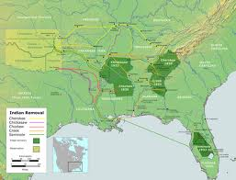
Trail of tears
The Trail of Tears is a name given to the forced relocation and movement of Native American nations from southeastern parts of the United States following the Indian Removal Act of 1830.

Slide 5
Trail of tears

Slide 6
Carlisle Boarding school c.1900

Slide 7
Ojibwe girls Learning to Sew

Slide 8
Removal to where???
Reservation: an area of federal land reserved for an Native American Tribe -often invaded by settlers and tribes sometimes refused to stay

Slide 9
“Indian territory”
Around 33 tribes
Were moved here
From all over
The country.

Slide 10
Answer these questions in your notebook NOW:
Why would the US government want to assimilate Native Americans?
Why would the government want to move Native Americans to reservations?

Slide 11
US government Policies of removal
Dawes Act 1887: tribe could no longer own reservation land as a group, but was distributed among individuals. Each family got a portion of land to hold or sell. This was against many tribes’ notions of land- no ownership, buying, or selling.
General Allotment Act 1887: allowed government to sell “surplus” Indian lands to non-Indian homesteaders

Slide 12
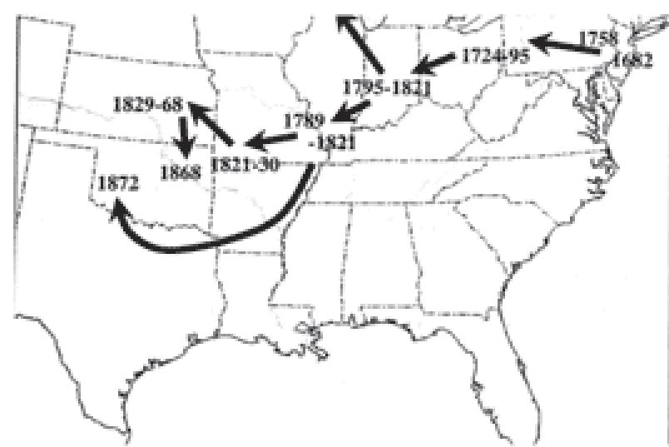
Delaware nation removal

Slide 13
Results of these policies
Overall the Dawes Act and the General Allotment Act greatly decreased the amount of Native American owned land in the US
These acts also represent an attempt at assimilation by forcing tribes to settle in a confined area and hopefully become farmers instead of hunting nomads.

Slide 14
“indian new deal”
The Indian Reorganization Act of 1934: was sometimes called the Indian New Deal. It laid out new rights for Native Americans, reversed some of the earlier privatization of their common holdings, and encouraged tribal sovereignty and land management by tribes.

Slide 15
Reservations today
There are about 310 Indian reservations in the United States, meaning not all of the country's 550-plus recognized tribes have a reservation—some tribes have more than one reservation, some share reservations, while others have none
The collective geographical area of all reservations is 2.3% of the area of the United States

Slide 16
Tribal sovereignty
Because tribes possess tribal sovereignty, even though it is limited, laws on tribal lands vary from the surrounding area.
These laws can permit legal casinos on reservations, for example, which attract tourists.
The tribal council, not the local or federal government, generally has jurisdiction over reservations. Different reservations have different systems of government, which may or may not replicate the forms of government found outside the reservation.

Slide 17
Reservations today
As of the year 2000, a majority of Native Americans live somewhere other than the reservations, often in big western cities such as Phoenix and Los Angeles.
In 2012, there were over 2.5 million Native Americans with about 1 million living on reservations

Slide 18
Reservations today
The quality of life on some reservations is comparable to that in the developing world, with issues of infant mortality, life expectancy, malnutrition and poverty, and alcohol and drug abuse.

Slide 21
