Slide 1
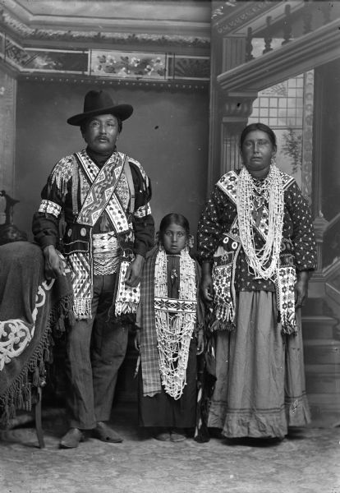
Native American Movements
Ms. Kainz
AE I-Fall 2010

Slide 2
Lesson Overview
European Arrivals Overview
Native American Removals
European Arrivals to WI Area
Case Study: Ho-Chunk Tribe and Charles Van Schaick’s photography

Slide 3
European Arrivals
Led to genocide and warfare
Displacement from their lands
Internal warfare
Enslavement
epidemic disease = the overwhelming cause of the population decline of the Native Americans (lack of immunity to new diseases brought from Europe)

Slide 4
European Arrivals
Westward expansion and Manifest Destiny
History of Native American land being purchased, by treaty or by force
Land exchange notion- early 19th century
Process ended in all land in the east exchanged for new land in the west- became law with the Indian Removal Act of 1830

Slide 5
Indian Removal Act of 1830 and Assimilation Policy
Allowed the government to negotiate removal treaties with the various tribes
→ the “five civilized tribes” (Chickasaw, Choctaw, Creek, Seminole, and Cherokee) removed from east of Mississippi to parts of Oklahoma and Kansas= Trail of Tears
Seminoles refused→ Second Seminole War
1850 to 1930-assimilation policy= Indian people were encouraged or forced to give up their languages, customs, religions, and ways of life

Slide 7
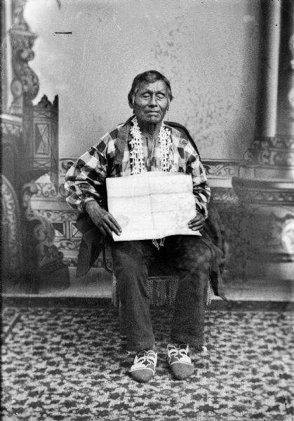

Slide 8
European Arrivals- WI Area
Each tribe is culturally distinct with own language and history
1634 Jean Nicolet, a French fur trader, came to present day Green Bay
-arrival of French to Great Lakes area different than the other European arrivals in the East (they wanted land)
-French wanted trade partners

Slide 9
Great Lakes Tribes around 1600

Slide 10
European Arrivals- WI Area
French adapt to Native culture- food, dress, customs, marriage
But European trade goods and French culture affect Native Americans too
-new technology- farming, domestic wares, firearms
Eventually leads to Indian removal of Great Lakes tribes as well-to the west across the Mississippi- Kansas and Oklahoma

Slide 11
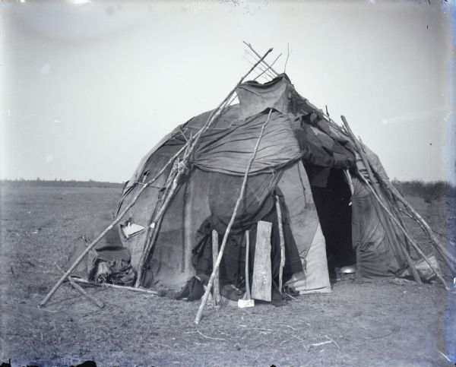

Slide 12
The Ho-Chunk Tribe
Lived in Western Great Lakes region around Green Bay
2 major clan divisions: Earth (8 clans including the Bear clan=war chiefs) and the Sky (4 clans including the Thunderbird clan=peace chiefs)
Leaders governed with help of a council with members from each clan
Had to move south, because of encroaching tribe near Lake Michigan and Superior- ran into the Illinois Confederacy
Ho-Chunk Split around 1570:
3 tribes to Iowa area, main body in villages near Green Bay to defend homeland

Slide 13
The Ho-Chunk Tribe
-Population decline and dependence on European trade goods = vulnerable to encroachment from white settlers
-mineral wealth of lands attracted miners
-1803 Louisiana Purchase, now in middle of US not edge
-War of 1812- but fought with Britain who lost
-By 1825, more than 10,000 miners lived on Ho-Chunk homelands
-1827 Chief Red Bird retaliated- captured, Ho-Chunk negotiations for his release cost them their lead-rich land in Illinois.
-After Blackhawk war (in which some Ho-Chunk helped fight the Americans with the Sauk) Ho-Chunk forced to cede much of land in exchange for land in western Iowa.
-5 years later, 20 individual tribe members ceded remaining lands east of the Mississippi in exchange for more land in Iowa.
-1820s- removal period- instead of giving land in Iowa, government changes to land in Northern Minnesota.
-Some Ho-Chunk refuse to leave their homelands, and some left for Iowa and Minnesota and either stayed or returned.

Slide 14
The Ho-Chunk Tribe
-1862 Sioux Uprising- land in Minnesota taken in exchange for land on Crow Creek in South Dakota. The US Government ordered the Ho-Chunk to leave for their new land during the winter of 1863= more than 550 die )1/4 of tribe
More than 1200 survivors fled to Omaha Nebraska and eventually purchased a portion of Omaha reservation, some back to WI
Rebel faction rounded up again and again and sent back to Nebraska, but always came back to WI- eventually in 1881 Congress allowed Ho-Chunk to stay in WI and have own homesteads
Intense pressures to assimilate (Christianity, Boarding Schools)
The Wisconsin Ho-Chunk today are descendents of the rebel faction who refused to move out west to reservations.
Charles Van Schaick in Black River Falls and Wisconsin Historical Society work

Slide 15
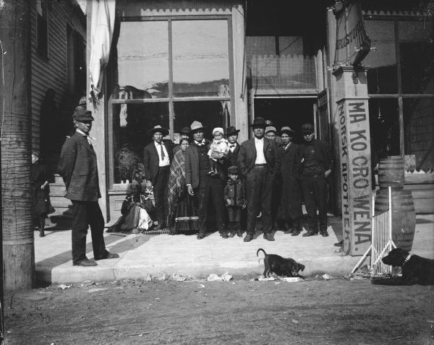

Slide 16
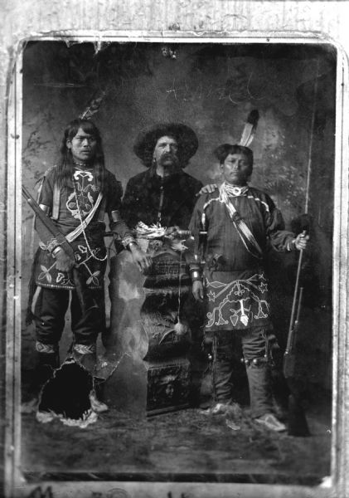
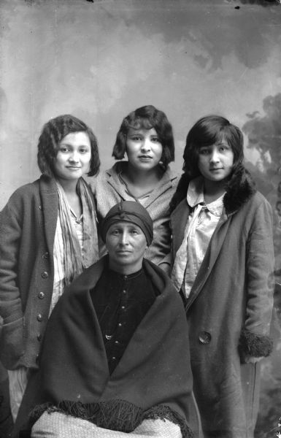

Slide 17
