Slide 1
Foreign and Domestic Policy

Slide 2
Domestic policy:
Domestic policy:
decisions, laws, and programs made by the government which are directly related to issues inside the United States. Sometimes domestic and foreign policies influence each other.
Major areas of domestic policy include:
tax policy, social security and welfare programs, environmental laws, and regulations on businesses and their practices.

Slide 3
Domestic Policy Issues
Federal Budget
Constitutional Rights
Crime and Drugs
The Economy
Education
Health Care
Immigration
Poverty
Minorities

Slide 4
Foreign Policy
Foreign policy:
Policies of the federal government directed to matters beyond (outside) US borders, especially relations with other countries.
International objectives pursued by a country in dealings with other countries,
The methods to achieve the objectives, in order to advance national interests.

Slide 5
Foreign Policy Issues
Defense
Democracy and Human Rights
Foreign Aid
The Global Environment
International Trade
Weapons Proliferation
Activities in Regions of the World

Slide 6
Goals of Foreign Policy
National Security
World Peace
Self- government (democracy)
Free and Open Trade
Concern for Humanity

Slide 7
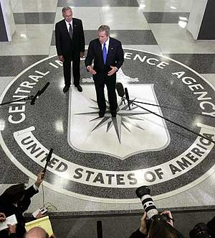
Goal 1: National Security
To remain free and independent
To be secure from unwanted foreign influence
Includes the use of ambassadors and treaties
Military
CIA
Central Intelligence Agency
FBI
Federal Bureau of Investigations

Slide 8
Goal 2: World Peace
Promote peace and prevent conflicts
Cooperation with governments of foreign nations
Help save lives, money, and resources in foreign nations
Give aid to foreign nations
Membership in The United Nations

Slide 9
Goal 3: Self Government/Democracy
Encourage the growth of democracy in other nations and regions
Fair elections, choices, individual freedoms
Immigration
Defined: To enter and settle in a country or region to which one is not native
Emigration
Defined: Migration from a place

Slide 10
Goal 4: Free Trade
Trade arrangements where tariffs or other barriers to the free flow of goods and services are eliminated.
The basic argument for free trade is based on the idea that each region should concentrate on what it can produce most cheaply and efficiently and should exchange its products for those it is less able to produce economically.

Slide 11
Free Trade Example: NAFTA
A trade agreement between the United States, Canada, and Mexico, which took effect January 1, 1994. Its purpose is to promote trade between one another and increase the efficiency and fairness of trade between the three nations.

Slide 12
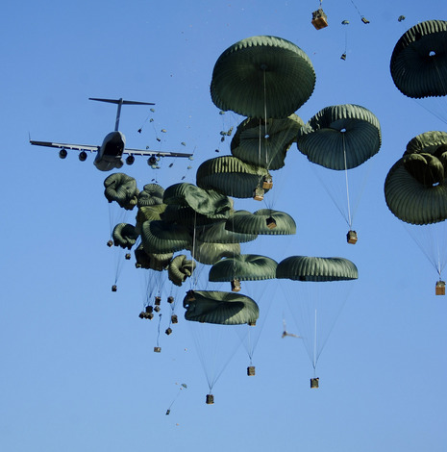
Goal 5: Humanitarian
Defined: Having concern for or helping to improve the welfare of other people.
Helps to provide political stability in other nations.
Examples:
Aid for natural disasters around the world
Aid for food shortages
Aid of medical supplies and technology

Slide 13
5 Goals of Foreign Policy
Please rank the following goals in order from most important to least important:
National Security
World Peace
Self- government (democracy)
Free and Open Trade
Concern for Humanity

Slide 14
Categories of Foreign Policy
Isolationism (avoidance of international relations)
Imperialism (policy of domination or empire building)
Interventionism (Involvement in another country’s affairs)
Which do you think is the best foreign policy? Explain your reasoning!
Which do you think is the best foreign policy for the US? For Kosova?

Slide 15
Responses in Foreign Policy Events
Do nothing * Pres. statement
Call for negotiations * Propaganda
Economic aid * Economic sanctions
Send military materials * Military presence
Military threats * Blockade
Mobilize troops * Subversive action
Use troops spy
Bombing assassination
Invasion weaken leadership

Slide 16
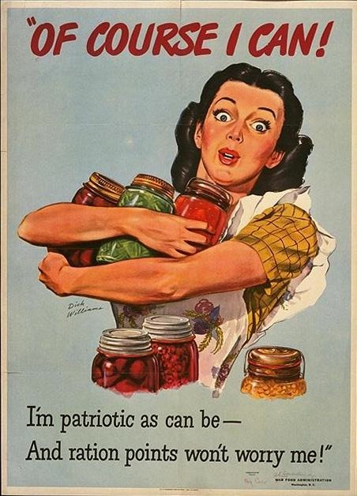
Domestic and Foreign Policies affect each other!
National mobilizations during wartime (Expansion of Governmental Power – increase in domestic wartime manufacturing)

Slide 17
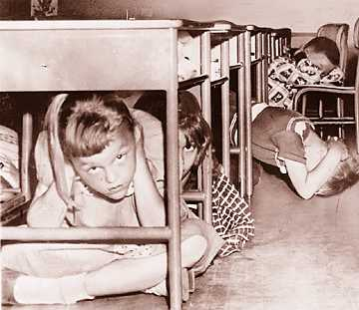
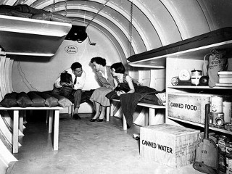
Domestic and Foreign Policies affect each other!
Waging the Cold War (Large and expensive military establishment , draft/military conscription, nuclear testing, civil defense drills, construction of bomb shelters, and the “space race”)

Slide 18
Domestic and Foreign Policies affect each other!
National Security : black defense projects, emergence of multibillion dollar defense firms,
embargoes have been imposed
on trade with certain countries
deemed to be adversaries of
United States- has affected
domestic producers,
expansion of FBI and CIA,
certain countries off limits to
U.S. citizens
increase in
border patrol

Slide 19
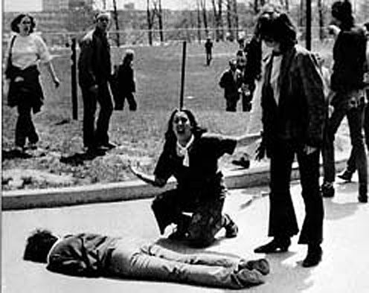
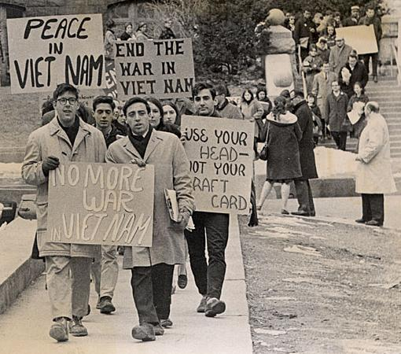
Domestic and Foreign Policies affect each other!
Domestic protests and disturbances may influence foreign policy (antiwar demonstrations during the Vietnam War may have persuaded some politicians to bring an end to the conflict)

Slide 20
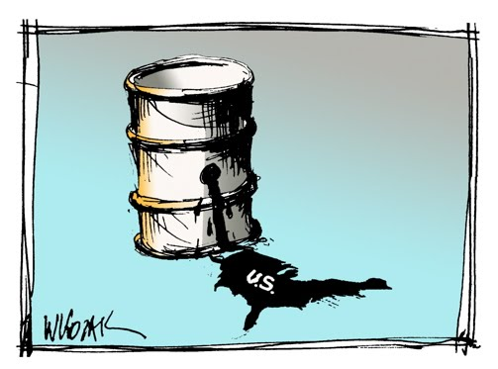
Domestic and Foreign Policies affect each other!
Dependence on foreign oil (may affect our foreign policy with Middle Eastern countries).

Slide 21
Domestic and Foreign Policies Affect Each Other!
Think of 3 more examples with your partner- look at your lists if you need help with ideas! You do not have to use just US examples- but they could be from other countries if you want!

