Slide 1
Warm up:
Write down and answer the following questions in your notebook:
Which crop greatly increased the need for slave labor in the American South?
What kinds of laws did states create in order to enforce/maintain the system of slavery?

Slide 2
Slavery and Inequality in the US
Unit notes, get out your notebook!

Slide 3
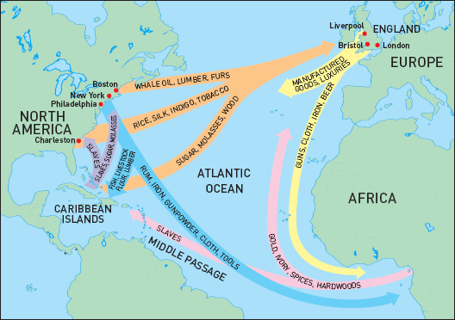
Triangular Trade
http://www.youtube.com/watch?v=jd4rRp48wcg
http://www.youtube.com/watch?v=zY5Hq2B4rM&feature=related

Slide 4
Unit Essential Questions
-What is the history and context of slavery in the United States and around the world?
-What was life like for slaves? What were forms of resistance and who was involved?
-Does slavery affect us (either positively or negatively) or is it still present in any form today?

Slide 5
Learning about Slavery
http://www.youtube.com/watch?v=hY6AxEkVF_8&feature=BFa&list=ULjd4rRp48wcg&lf=mfu_in_order

Slide 6
Slavery Timeline
1502 First reported African slaves in the New World
1803 Denmark is first to ban the slave trade.
1807 The United States passes legislation banning slave trade that will take effect the following year.

Slide 7
Timeline continued
1860s The Atlantic slave trade was abolished over a 30-year period ending with Portugal’s 1836 ban on slave trading. But legal abolition did not end the still profitable trade. It continued illegally well into the 19th century. As long as there remained a market for slaves in the Americas, mostly in Brazil and Cuba, the trade would continue until the 1860s.

Slide 8
Development of a slave labor based economy in the South
Cotton was a cash crop that required a lot of labor, and was very profitable, especially after the invention of the cotton gin:
As cotton production expanded, demand for slaves also rose
This also drove planters west to find new land for growing cotton
The Southern economy was still based on agriculture, and urbanization and industrialization developed more slowly than in the Northern states.

Slide 9
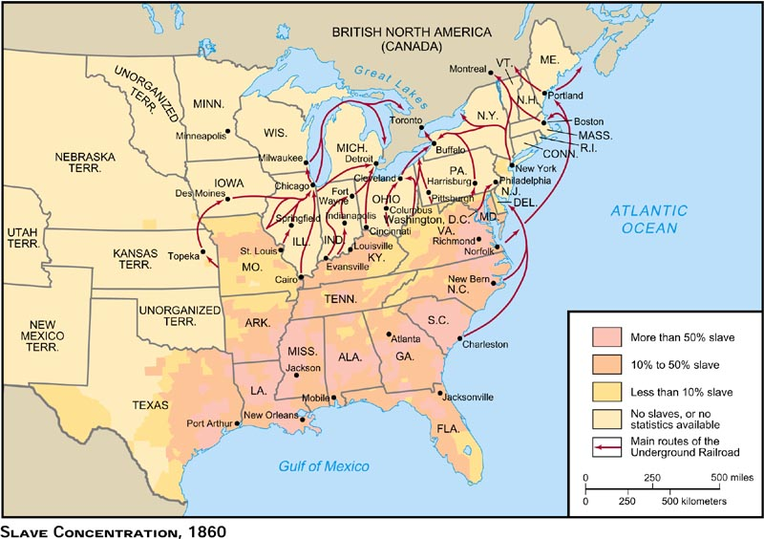
Slave Concentrations in the US

Slide 10
Slavery in the Constitution
You tell me: What was the 3/5ths Compromise?
Your answer from yesterday- why didn’t the founding fathers end slavery when they were drafting the constitution?

Slide 11
Northern and Southern Views on Slavery
By 1800 there were about 50,000 slaves in the North- compared to 1 million in the South
Most white northerners still viewed African Americans as inferior, and the laws still severely limited the rights of free African Americans in the North.
Not all northerners wanted to end slavery, but a small minority did- they were called abolitionists. Northern bankers, merchants, and some workers generally opposed ending slavery.

Slide 12
Compromises to save the Union?
Missouri compromise 1820
Compromise of 1850
Fugitive Slave Act
Kansas-Nebraska Act 1854

Slide 13
The Missouri Compromise 1820
Slavery prohibited in the Louisiana territory north of the 36 60’ line, except in Missouri
Maine enters the union as a free state
Missouri enters the union as a slave state
Significance: the compromise preserved the balance of free and slave states in the Senate. However, it marked the beginning of the sectional conflict that would lead to civil war.

Slide 14
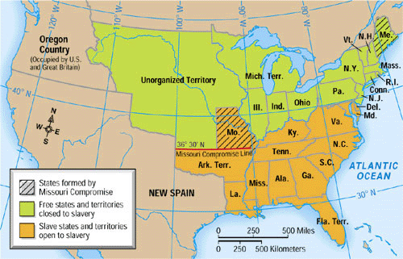
Missouri Compromise

Slide 15
Compromise of 1850
California enters as a free state
Slavery issue to be decided by popular sovereignty in Utah and New Mexico territories
New, stricter Fugitive Slave Act
Slave trade but not slavery is ended in Washington DC
Significance: This compromise was not a good solution to the sectional conflict because it pushed many people to more radical positions.

Slide 16
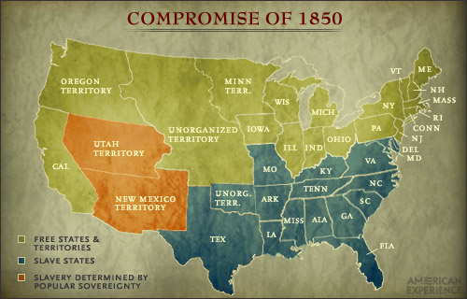

Slide 17
Fugitive Slave Act
The law that required all citizens to aid in catching runaway slaves.
If you helped a fugitive slave you could be fined or imprisoned.
Review: http://www.youtube.com/watch?v=wZaFJM-CMbs

Slide 18
Kansas-Nebraska Act 1854
Created potential for slavery in Kansas and Nebraska territories by allowing for popular sovereignty
Caused violence between pro and anti slavery groups as they fought for control- “Bleeding Kansas”
Significance: This overturned the Missouri Compromise. Although it was meant to unite the nation, it caused further division and led to the creation of the Republican Party.

Slide 19
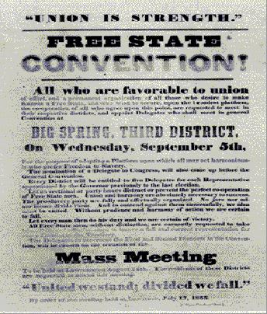

Slide 20
Resistance and Revolt
Abolitionists, slaves, and freed African Americans resisted in many different ways.
Passive Resistance was a method used by slaves to resist their servitude.. How might slaves passively resist?
Active Resistance was another method also used- this is the more classic violent revolt, or abolitionists campaigning for their cause, giving speeches, writing for newspapers…

Slide 21
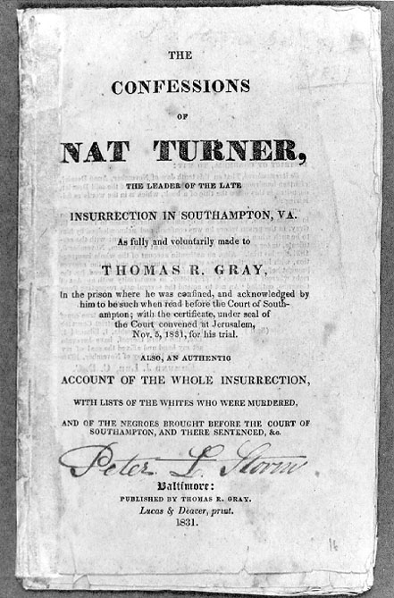
Nat Turner’s Rebellion
I have a short reading on Nat Turner’s Rebellion
You can either read it by yourself or with a partner-
But please read it and answer the following question:
Was Nat Turner’s Rebellion successful? Why or why not?

