Slide 1
Found Poem or Written Response Assignment
After reading about Nat Turner’s Rebellion and the other collection of sources describing life in slavery, you have a choice of doing either a found poem or a written response.

Slide 2
Found Poem
Found poems take existing texts and refashion them, reorder them, and present them as poems. The literary equivalent of a collage, found poetry is often made from newspaper articles, street signs, graffiti, speeches, letters, or even other poems.
So you need to read through the texts keeping this in mind: reading the passage and find the most important words or phrases that convey the meaning of the text- take notes on those words or phrases!

Slide 3
Tips for creating a found poem
YOUR FOUND POEM WILL HAVE THE THEME OF UNDERSTANDING LIFE IN SLAVERY- the rest is up to you!
Words and phrases can be rearranged, they need not be used in the order in which they appear in the original text
Words can suggest your point of view and an idea that might not be stressed in the original text
Give the finished poem a title
Poem can be written from a fictional character’s perspective

Slide 4
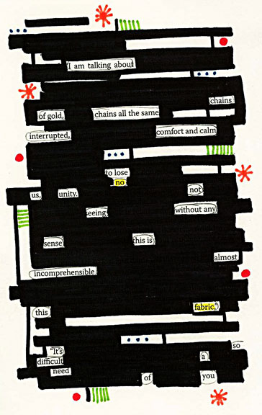
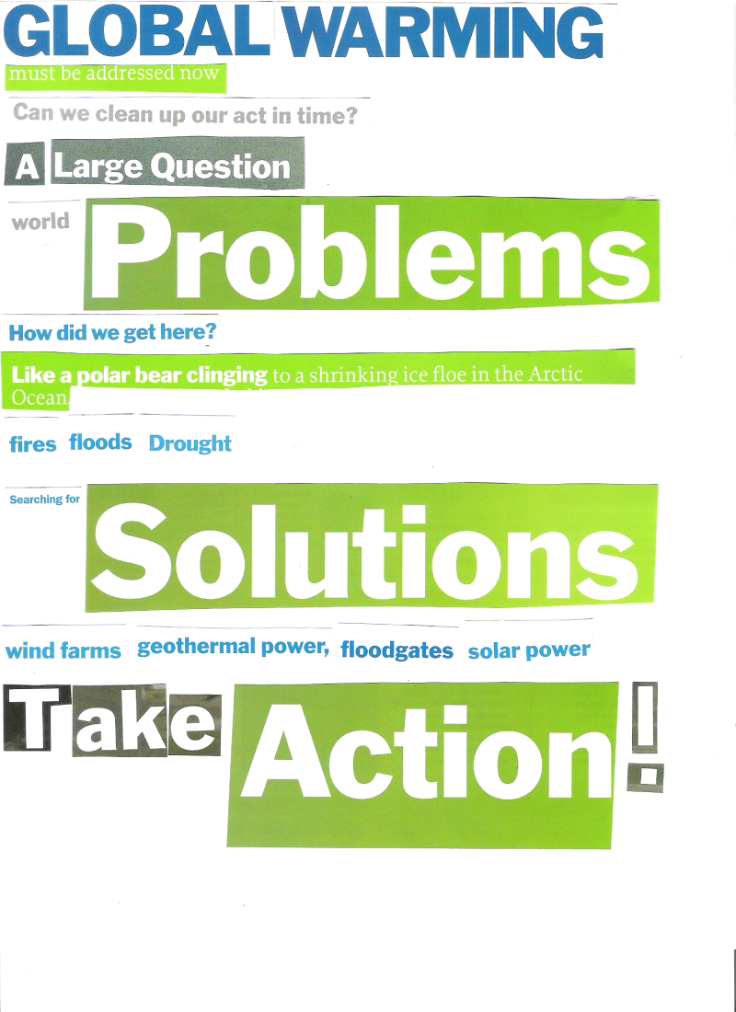
Examples

Slide 5
Written Assignment
If you do not feel like doing a found poem, you can write a one-page written response on life in slavery using the sources!

