Slide 1
A war to free the slaves?
Throughout this lesson we’ll be reading through a few primary source excerpts and answering a few questions.
We will be doing this as a whole class, not in groups.
The questions are on the next few slides, you must copy them down into your notebook and answer them as we go through them. You will turn this in for a grade!

Slide 2
Original Proposed 13th Amendment
Please put the text of this proposed amendment into your own words- what is this saying? Who will it benefit most?

Slide 3
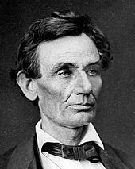
Lincoln’s First Inaugural Address
What does the term inaugural mean?
What reasons does Lincoln offer for why he will not interfere with slavery?

Slide 4
Lincoln’s First Inaugural Address
What does Lincoln promise the leaders of slaveholding states in the second excerpt?
How might US History have been different if the southern states had accepted this offer to return to the Union and guarantee slavery through the 13th amendment?

Slide 5
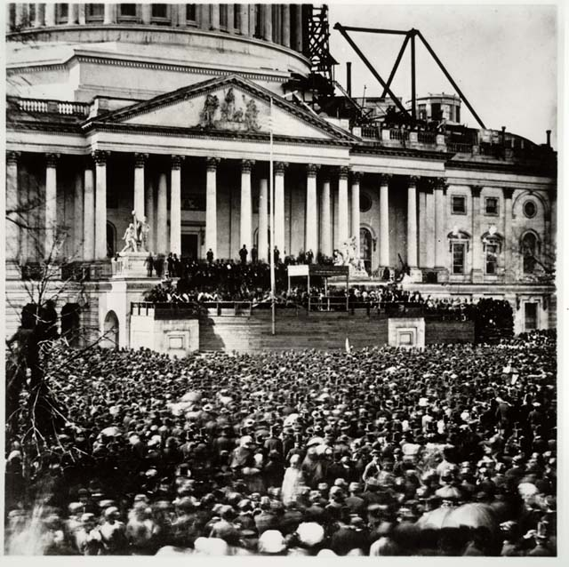
Abe’s First Inaugural Address

Slide 6
Emancipation Proclamation
Define the words ‘emancipation’ and ‘proclamation’
This proclamation was issued over 3 months, from the date it was supposed to take effect. What was the significance of it not taking effect immediately?

Slide 7
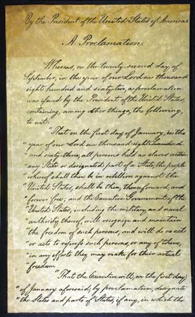
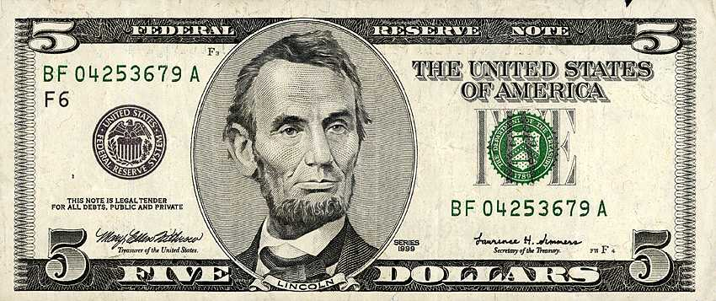
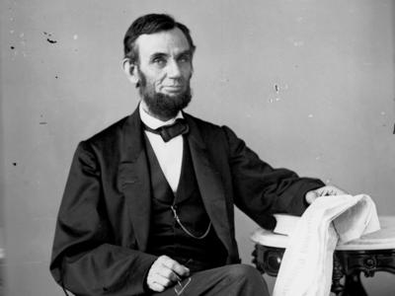

Slide 8
Emancipation Proclamation
Why doesn’t the Emancipation Proclamation simply declare immediate freedom for ALL people held as slaves anywhere in the US?
One criticism of the EP was that it might ‘invites servile insurrection’ or slave revolts. Do you agree? Why or why not?

Slide 9
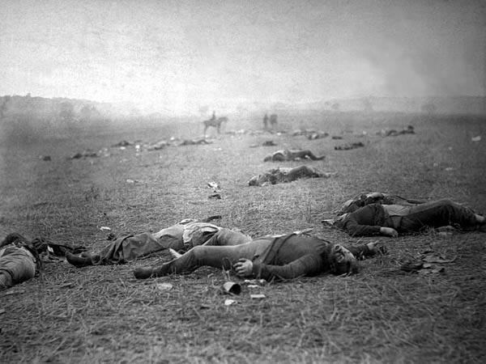
What are they fighting for?
Tell me why you think Lincoln and the Republicans were willing to fight a war to preserve the Union.

